Slide 1
CIS 565 FINAL PROJECT CUDA Feature Matching and Object Tracking Milestone 3 by Yash Vardhan

Slide 2

MILESTONES
Week 1 – Object Tracking on CPU
Week 2 – Object Tracking on GPU and optimizations
Week 3 – Feature Matching on CPU and GPU setup
Week 4 – Feature Matching on videos and GPU optimizations

Slide 3
FEATURE MATCHING pipeline using opencv
Feature Detection -- Corner points (movement invariant)
Feature Description -- Describe area around detected corner points between 2 images to be matched
Feature Matching -- Match keypoints between 2 images while removing outliers.

Slide 4
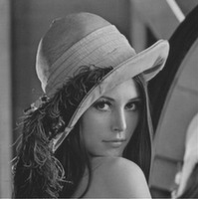


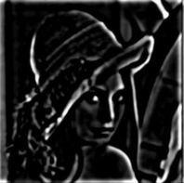
FEATURE DETECTION
Used Difference of Gaussians (DoG) with different width parameters (σ) to detect corner points.
Scan for local minima/maxima, calculate Hessian and apply curve test.
σ = 2 σ = 4

Slide 5
Feature description and matching
Description – BRIEF descriptors
Create a patch by taking 256 points around keypoint.
For all pairs in patch create binary string by: Intensity(p1) > Intensity(p2).
Matching
Calculate Hamming distance between all keypoint descriptors in 2 images.
Use k-Nearest Neighbors to get nearest match and remove outliers by applying False Positive Ratio Test.

Slide 6
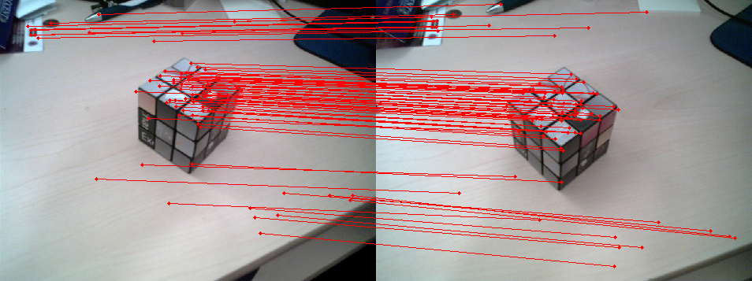

Slide 7
USING CUDA – Naïve approach
Computing each keypoint independently.
Invoked 1 thread per pixel.
Used shared memory whenever possible.
Avoided redundant computations again and again.

Slide 9
NEXT WEEK
Feature Matching on Videos and performance optimizations
Stretch Goals –> In Real Time!!

